Slide 1
Atrium Health Hospital at Home

Slide 2
Purpose
Offer an alternative care location to appropriate patients who would otherwise be inpatient at one of our bricks and mortar facilities
Improve capacity at CMC, Pineville and Cabarrus- ED and Inpatient referrals
Live for ED referrals at Mercy, Union and University as of 3/22/2021
Multidisciplinary coordinated patient care
Inpatient care for patients in the comfort of their homes
Deviation from these guidelines should be appropriate, reasonable, and considered on a case-by-case basis based on patient status; and nursing, and provider judgement.

Slide 3
Considerations for All H@H Patients
Patient safe to be managed in their home environment
Able to transfer from bed to chair, to restroom, etc
Home environment safe for medical support staff
Family support is stable and not abusive.
Ability to obtain necessary prescriptions
Patient/Family speaks English/Spanish
Patient should be stable for General Medical Floor
Oxygen support 4LNC or Less and stable work of breathing
Hemodynamically stable for q6h-8h vital sign monitoring
Patient unlikely to require medical procedures
Patient requires daily to twice daily advanced interventions
Examples- IV antibiotics, IV lasix, IV steroids, nebulizer treatments
Patient/Caregiver has capability to use monitoring devices: BP Cuff, pulse oximeter, and thermometer
Patient has working home phone and accurate home address (does not need smartphone)
Patient/Caregiver understands the goal and plan of care for H@H
Deviation from these guidelines should be appropriate, reasonable, and considered on a case-by-case basis based on patient status; and nursing, and provider judgement.

Slide 4
Exclusion criteria for H@H
Patients that are:
On hospice, outpatient transfusion dependent, or receiving dialysis
Experiencing an acute psychiatric condition
Pregnant
Under the age of 18
Unable to obtain prescribed medications when departing the ED
Option: Myers Park pharmacy available Monday- Friday, 8a-4p
Patients living in:
South Carolina
Outside of 30-mile radius
Group home or skilled facility (to include SNF, ALF)
Typically, able to manage patients in independent living facilities/senior apartments. The limiting step are locations that have in house medication management and providers who take over care.
Unsafe home environment or domestic violence situation
Patient that require:
IV narcotic pain control after leaving ED
NOT appropriate to admit in lieu of patient signing out AMA
Deviation from these guidelines should be appropriate, reasonable, and considered on a case-by-case basis based on patient status; and nursing, and provider judgement.

Slide 5
Target Diagnoses
Cellulitis
Pyelonephritis
Uncomplicated Diverticulitis
Community Acquired Pneumonia/COVID19 Pneumonia
Congestive Heart Failure
Acute COPD/Asthma Exacerbations
Hyperglycemia without DKA
Nausea, Vomiting, Dehydration
Hypertensive Urgency
Atrial fibrillation with rapid ventricular response
Deviation from these guidelines should be appropriate, reasonable, and considered on a case-by-case basis based on patient status; and nursing, and provider judgement.

Slide 6
Clinical Selection Cellulitis/Pyelonephritis/Diverticulitis
Exclusion
Evidence of urinary tract obstruction (question: hydroureter or hydronephrosis on CT)
Evidence of unexcised abscess on imaging (possible imaging: CT abdomen for diverticulitis, US for cellultis)
Requiring more than BID IV antibiotics (may be able to handle TID depending on patient volume)
Deviation from these guidelines should be appropriate, reasonable, and considered on a case-by-case basis based on patient status; and nursing, and provider judgement.

Slide 7
Clinical Selection Community Acquired Pneumonia/COVID19 Pneumonia
Exclusion
Unstable VS
RR ≥ 30
SBP ≤ 90, DBP ≤ 50 (may deviate based on clinical judgement)
Oxygen Saturation ≥93% on 4L via NC or Less
Pleural effusion requiring intervention
Cavitary lung lesion/ concern for TB
Requiring more than twice daily IV antibiotics
Deviation from these guidelines should be appropriate, reasonable, and considered on a case-by-case basis based on patient status; and nursing, and provider judgement.

Slide 8
Clinical Selection Congestive Heart Failure
Exclusion
New this visit diagnosis of HF
No evidence of end- organ dysfunction
Unstable vital signs:
Systolic BP<100, HR<50 and >110 at rest
O2 sat <90% on RA or <92% on 2L-4L/min.
Cr greater than 1.5 or 50% increase from baseline
Able to perform daily weights
Deviation from these guidelines should be appropriate, reasonable, and considered on a case-by-case basis based on patient status; and nursing, and provider judgement.

Slide 9
Clinical Selection COPD/Asthma
Exclusion
BAP-65 Score of 2 or more WITH altered mental status (1 pt for each):
BUN ≥ 25 mg/ dl
AMS
Pulse ≥ 109 bpm
Oxygen saturation < 90% on 4LNC with stable work of breathing (no accessory muscle use, able to speak in full sentences, pass walk test when appropriate, etc)
Respiratory Rate ≥ 30 (based on CURB65)
Inability to use nebulizer machine to perform treatments in the home
Deviation from these guidelines should be appropriate, reasonable, and considered on a case-by-case basis based on patient status; and nursing, and provider judgement.

Slide 10
Clinical Selection Hyperglycemia without DKA
Exclusion:
Evidence of DKA or HHNS:
Abnormal anion gap
CO2 < 19
Ketones in urine?
Initial diagnosis of diabetes at this visit
Requiring IV insulin administration once transferred out of ED
Cr greater than 50% elevation from baseline
Deviation from these guidelines should be appropriate, reasonable, and considered on a case-by-case basis based on patient status; and nursing, and provider judgement.

Slide 11
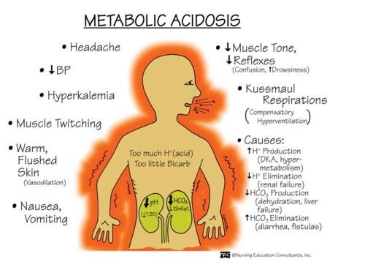
Clinical Selection Dehydration/ AKI
Exclusion:
Inability to control with nausea/ vomiting/ diarrhea with medication
Cr elevation greater than 50% of baseline
Sodium less than 130
CO2 < 19
Metabolic Acidosis
Deviation from these guidelines should be appropriate, reasonable, and considered on a case-by-case basis based on patient status; and nursing, and provider judgement.

Slide 12
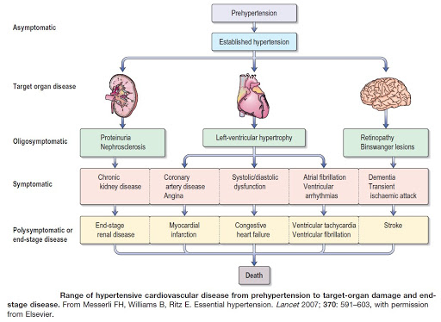
Clinical Selection Hypertensive Urgency
Exclusion:
Systolic BP ≥ 200
Evidence of End Organ Damage
Hypertensive urgency:
Severe elevations in BP without progressive target end organ dysfunction
Hypertensive emergency:
Severe elevations in BP (>180/120) complicated by evidence of impending or progressive target organ dysfunction
Deviation from these guidelines should be appropriate, reasonable, and considered on a case-by-case basis based on patient status; and nursing, and provider judgement.

Slide 13
Clinical Selection Atrial Fibrillation
Exclusion:
New this visit diagnosis
A-fib is NOT the sole arrhythmia for the patient
Patient is deemed unstable atrial fibrillation
Evidence of ACS/Acute CHF/New Valvular Abnormality
Hemodynamically unstable, systolic BP < 90
HR 120 or greater without continuous IV therapy
Oxygen saturation less than 90% on room air
Deviation from these guidelines should be appropriate, reasonable, and considered on a case-by-case basis based on patient status; and nursing, and provider judgement.

Slide 14
Practical Questions
Can I admit my patients 24/7?
No, we accept admissions 7 days a week 7AM-7PM
Do I need to leave the IV in my patient?
No, we can place those in the home and have US assist
Does my patient need to have insurance?
No, we accept all payors
Does my patient need to have a primary care provider?
No, we are integrated with Access to Access who can assist at discharge
Can I refer a patient who live in an Assisted Living Facility or Skilled Nursing Facility?
No, we are unable to practice inside those facilities at this time.
Can I admit my patient to only manage their surgical drains, central catheters, or other devices?
No, we can assist with this management if there are other indications for admission but if this is the only reason follow up is needed then Home Health Nursing only would be adequate.
Does my patient need to live in a certain location?
Yes, Still working within a 30-mile radius of city center to maximize volume and census support
Deviation from these guidelines should be appropriate, reasonable, and considered on a case-by-case basis based on patient status; and nursing, and provider judgement.

